Slide 1
Bluestone personas

Slide 2
Research gap
Although BlueStone provides a wide range of jewellery, detailed product information, search options, filters, and online purchasing facilities, there is a gap in understanding how different types of users experience the website. The interface provides many choices, but the large number of categories, filters, product details, and promotional elements may increase cognitive load, especially for first-time users, older users, and users shopping on mobile devices. There is also scope to investigate whether users can easily understand product information, compare jewellery, determine the right size, evaluate authenticity, and complete purchases without confusion. Therefore, further research is needed to identify usability, accessibility, navigation, personalization, and trust-related issues in the BlueStone website and develop a simpler, more user-centred shopping experience.

Slide 3
Key research gaps
Area | Research Gap
Navigation | Large number of categories may make finding specific products difficult.
Learnability | First-time users may need time to understand the extensive shopping options.
Accessibility | More attention could be given to users with different accessibility needs.
Product Information | Users may need clearer information about size, materials, authenticity and pricing.
Comparison | Comparing multiple jewellery products could be made more efficient.
Mobile Experience | Extensive information and filtering may create additional effort on smaller screens.
Personalization | Recommendations could be more closely tailored to individual preferences and browsing behaviour.
Trust | Users may need stronger visual cues around authenticity, certification, warranty and returns.
Error Recovery | Checkout and form errors could provide clearer guidance for correction.
User Satisfaction | There is scope to reduce unnecessary steps and cognitive load while maintaining the extensive product selection.

Slide 4
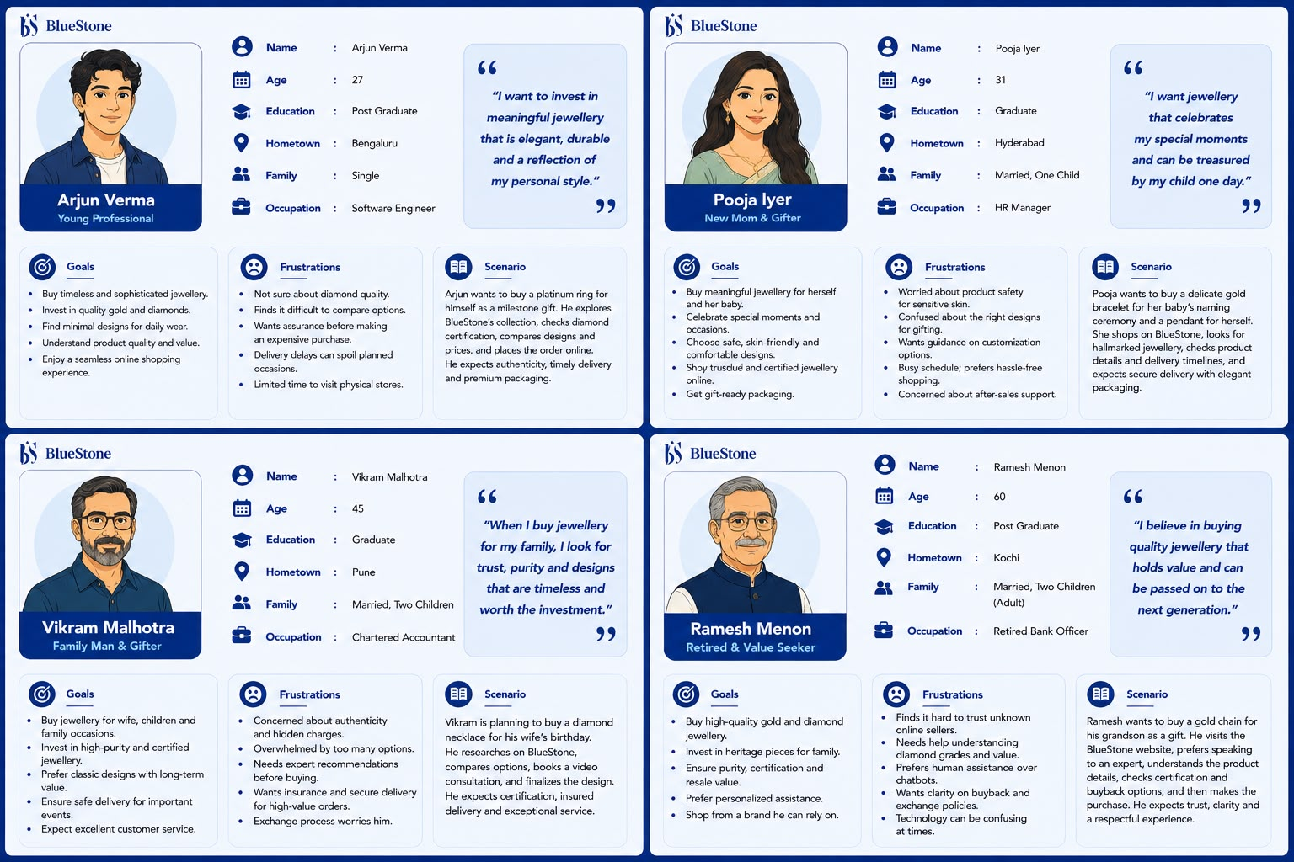
Persona 1

Slide 5
Persona 2

Slide 6
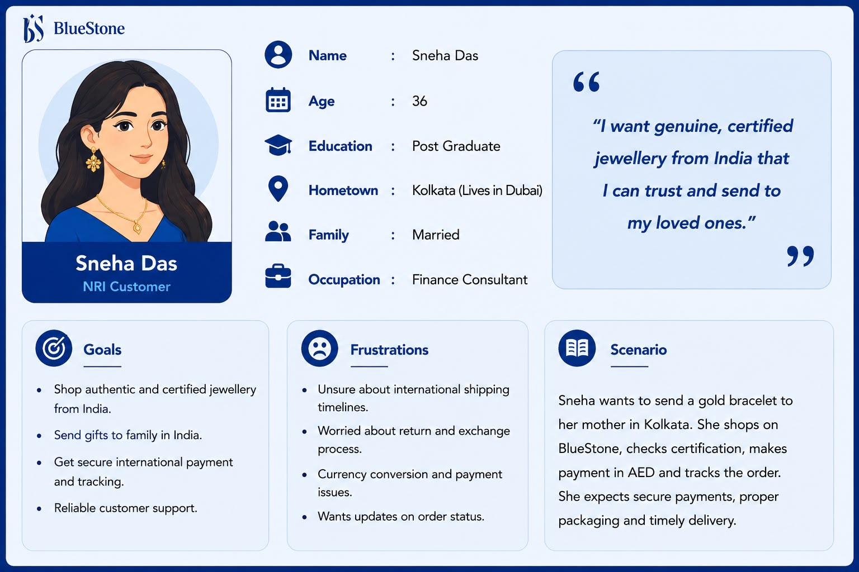
Persona 3

Slide 7
Persona 4

Slide 8
Persona 5

Slide 9
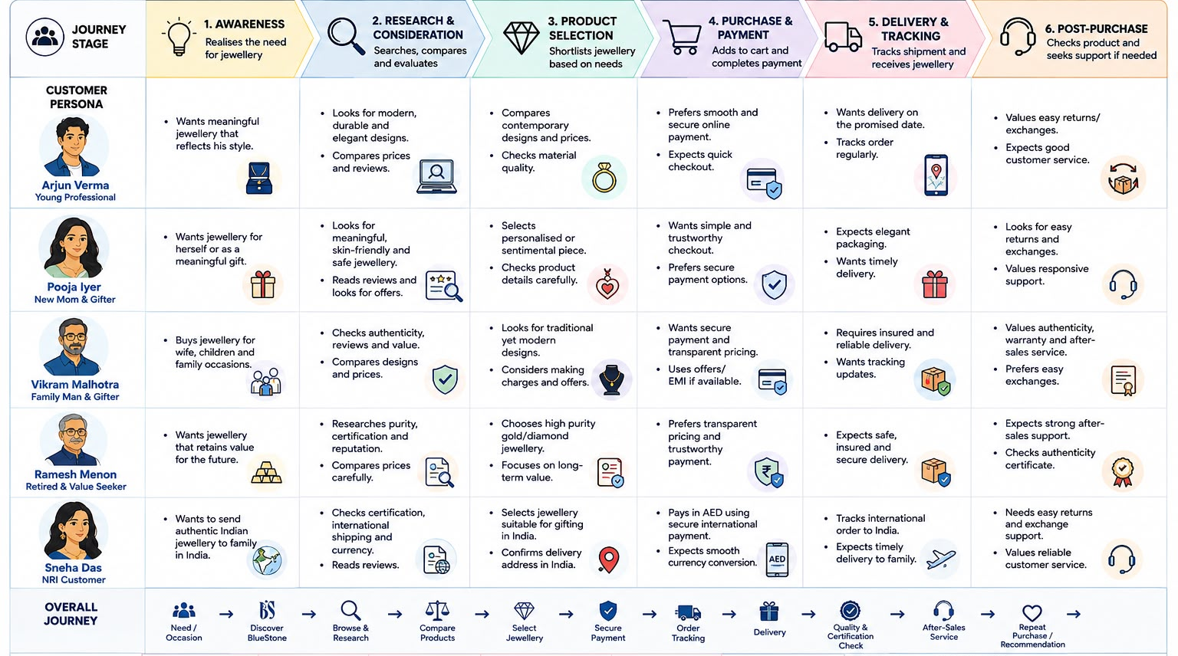
USER JOURNEY

Slide 10
THANK YOU
NAME : Mahek Katharotiya
PRN : 1262242460
PANEL : F

